Slide 1


Web Accessibility And Cross Platform Development
Presenters
Miracle Dsouza
Rahul Dcosta
Notes:
SHORT TITLE

Slide 2


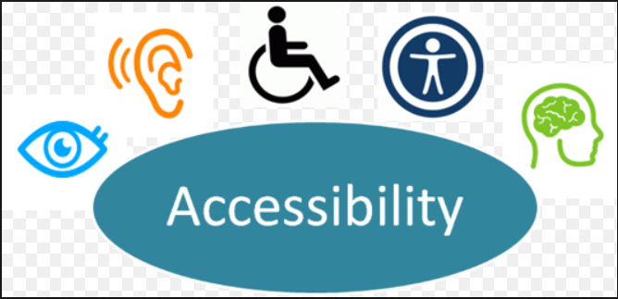
Introduction to Accessibility Web Development

Slide 3
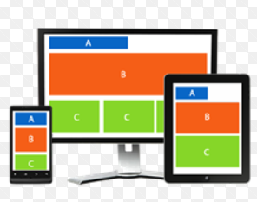



Accessibility development: Benefits

Slide 4
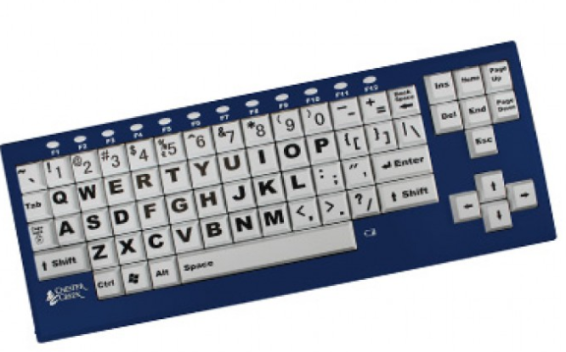



Assistive technology
Screen reader
Screen magnifier
Speech recognition software
Alternative input devices

Slide 5
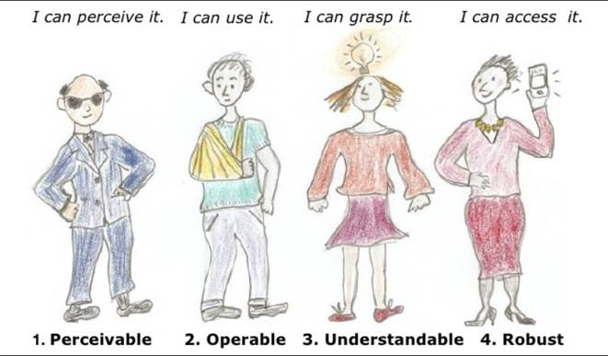
Principles of WCAG 2.O
Features of Accessible Websites
Good use of HTML headings Accessible with keyboard Accessible images Accessible menus Accessible forms Accessible tables Effective use of color Meaningful link text ARIA landmark roles ARIA for web applications

Slide 6
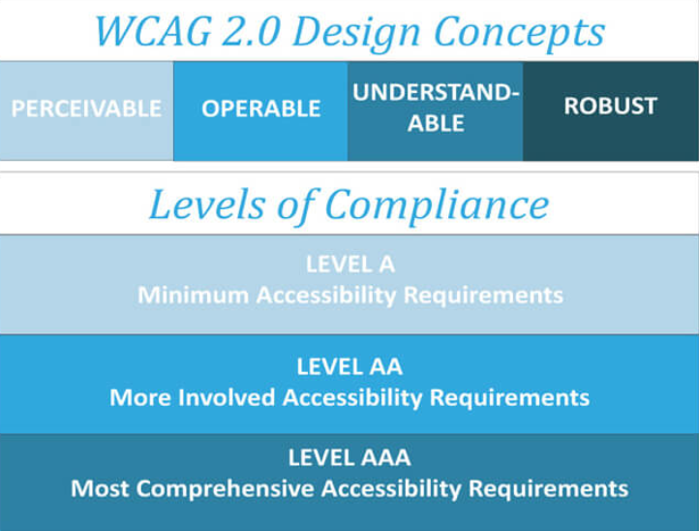
Web Content Accessibility Guidelines(WCAG) 2.0

Slide 7
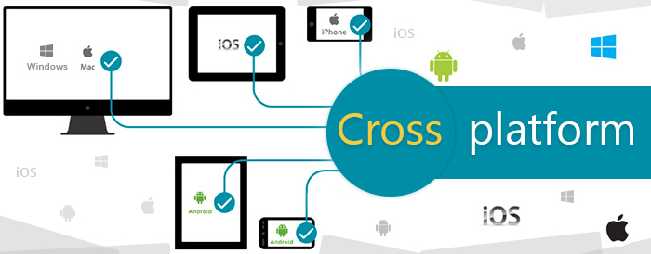
Cross platform development

Slide 8


Responsive UI & Mobile first approach
Responsive - Flexible layouts, flexible images and cascading style sheet media queries.
Mobile first approach - Design for smaller screens first – progressive enhancement.
Is there a difference between the two?
mobile-first is actually a design strategy
responsiveness is the result of a technical approach

Slide 9
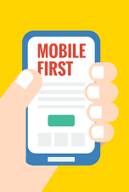
Why Mobile first and responsive UI’s?
Did you know ??
68 million Google searches are carried out on mobile devices every hour around the globe?
What’s more: 69% of travelers start their online searches on a mobile device!
In fact, mobile bookings in the travel industry grew by 1700% between 2011 and 2015, moving from 1% to 18% of online revenues.

Slide 10
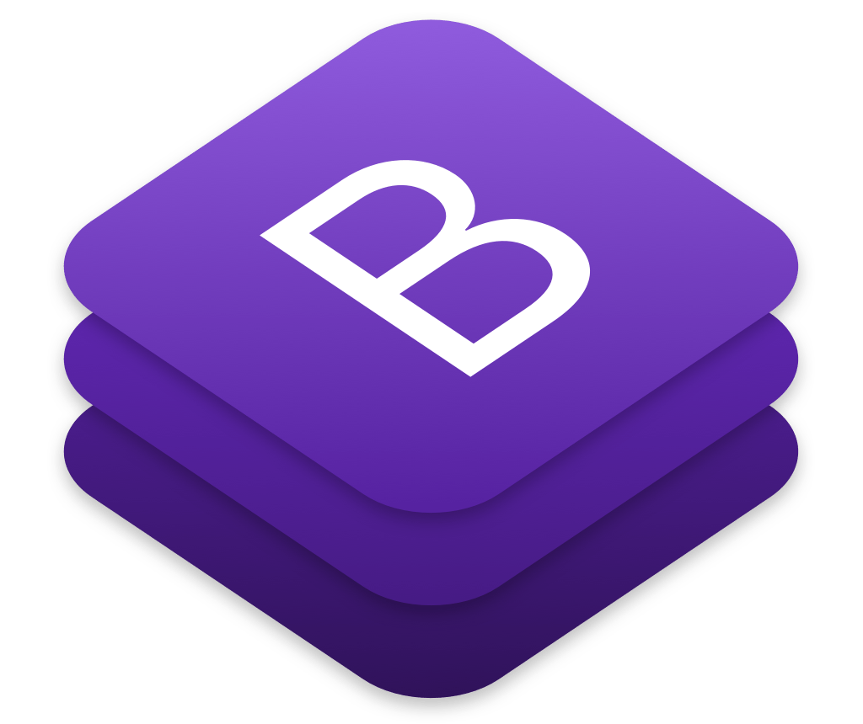
What is bootstrap?
It is a library for responsive, mobile-first projects with the world's most popular front-end component library.
It is an open source toolkit for developing with HTML, CSS, and JS.

Slide 11

Advantages of Bootstrap
Easy to use
Responsive features
Mobile-first approach
free set of tools /common interface components.
Very less coding
Consistent design
Open source
Compatibility with browsers

Slide 12


